Slide 1



Marketing Analytics:
Turning Data into Growth
An executive review of ShopEasy's performance, revealing the hidden opportunities in customer sentiment and engagement data.
Ali Ahmad
Data Analyst

Slide 2




The "State of Strategy"
Our analysis uncovered a polarized performance landscape. While overall volume is down, the quality of customer interaction has arguably never been higher.
10.2%
15.4%
3.7
DEC CONVERSION
ENGAGEMENT RATE
AVG RATING
Strong rebound after an October dip to 5.0%.
Users are clicking. Content relevance is high.
Stable, but misses the strategic 4.0 target.

Slide 3


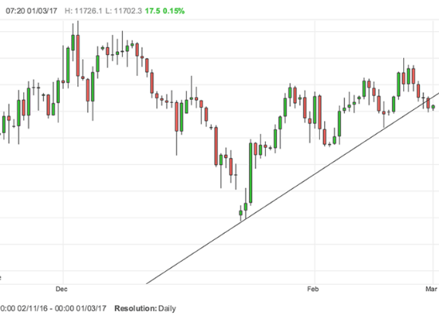
A Year of Peaks & Valleys
The January Peak (18.5%) Seasonal dominance driven by Ski Boots. The year started strong.
The May Slump (4.3%) A critical low point. No product category performed well, indicating a "content drought."
The Q4 Recovery Strategic adjustments worked. By December, we climbed back to double digits (10.2%).

Slide 4





The Engagement Paradox
We are seeing fewer people, but the right people.
Declining Views
Top-of-funnel traffic has dropped consistently. Our reach is shrinking.
The "3.7" Ceiling
Customer satisfaction is stuck. Mixed reviews are preventing us from reaching "Elite" status (4.0+).

Slide 5

Path to Growth
0 counter(action-counter)
Target High-Performers
Stop spreading budget thin. Double down on Kayaks & Ski Boots during Jan/Sept peaks.
0 counter(action-counter)
Revitalize Content
Fix the view drop. Pivot to Interactive Video and user-generated content to widen the funnel.
0 counter(action-counter)
Close the Feedback Loop
Break the 3.7 ceiling. Launch a specific campaign to address Mixed Reviews and resolve low-hanging complaints.

Slide 6




Image Sources
https://www.poundsterlinglive.com/images/graphs/1-3-pound-to-euro-exchange-rate-below-trend-line.png
Source: www.poundsterlinglive.com
https://img.freepik.com/premium-photo/three-stars-out-five-stars-customer-product-rating-review-3-stars-rating-concept-showcasing-review-theme-customer-feedback-satisfaction_165002-15017.jpg
Source: www.freepik.com
https://images.pond5.com/blueprint-strategy-target-and-intelligence-footage-312320479_iconl.jpeg
Source: www.pond5.com

